Slide 1

Realistic Encrypted network traffic classification based on Large Dataset
PRESENTED BY:
LIOR DAVIDYAN
ROTEM KOCHAVI
TAMAR REVAZISHVILI

Slide 2

Introduction
Encryption is becoming a standard practice in network communications, with protocols like TLS and SSL.
This increase in encrypted traffic poses challenges for network administrators and security systems.
Traditional tools like Deep Packet Inspection (DPI) are no longer effective due to encryption.
The need for accurate classification of encrypted traffic is critical for network security, compliance, and traffic management.

Slide 3
Problem Statement
Problem 1
Problem 2
Solution
Encryption methods obscure payload data, which previously provided insight into traffic.
Existing datasets used in encrypted traffic classification are often limited and lack real-world diversity.
Our project addresses these gaps by building a comprehensive dataset and using machine learning for traffic classification.

Slide 4
Project Objectives
Data Generation: Create a large, representative dataset that includes encrypted traffic from diverse applications and network behaviors.
--------------------------------------------------------------------------------------------
Real-World Scenarios: Simulate realistic network conditions such as packet loss and delays using Clumsy.
--------------------------------------------------------------------------------------------
Traffic Classification: Extract features and apply machine learning techniques for classification.

Slide 5
Related Work
Several studies have explored machine learning and deep learning techniques for encrypted traffic classification.
Most work has focused on statistical features such as packet size and inter-arrival times.
Deep learning models like ECNet have been successful in detecting malicious traffic but lack generalization for broader types of encrypted traffic.
Our work builds on these methods by focusing on a more comprehensive and diverse range of traffic types beyond just malicious traffic.

Slide 6
Crawler Development
Custom WebCrawler: Developed using Python and Selenium WebDriver.
Automated Interactions: Browsing, video streaming, file uploads, file downloads, and participation in Google Meet sessions.
Traffic Capture: Using Scapy and AsyncSniffer for real-time traffic capture, stored in PCAP files for analysis.
Network Condition Simulation: Using Clumsy to simulate real-world conditions like packet loss, latency, and bandwidth throttling.

Slide 7
Dataset Overview
The dataset contains 7,222 PCAP files across a range of applications and interaction types.
Categories include browsing, file downloads, file uploads, real-time audio, messaging, and video.
Traffic generated from 338 different websites and applications, making it highly diverse and representative of modern network traffic.
Each session is labeled with metadata like application type, timestamp, and network conditions for precise analysis.

Slide 8
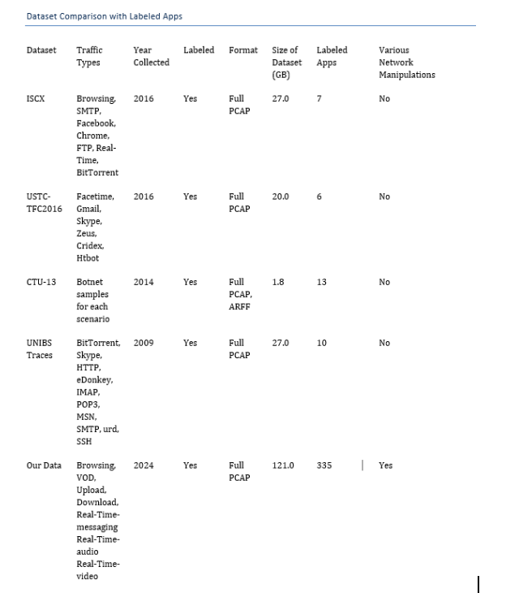
Dataset Comparison
A comparison of key datasets for network traffic analysis, highlighting traffic types, sizes, and labeling. 'Our Data' is the most comprehensive, with advanced manipulations like delays and packet loss, and significantly more labeled applications.

Slide 9
Feature Extraction
Packet Size Features: Minimum, maximum, mean packet sizes, small packet ratio.
TLS Record Features: Minimum, maximum, and mean TLS record sizes, as well as outgoing and incoming TLS counts.
Temporal Features: Inter-arrival times (min, max, mean) and TCP window size.
Flow Aggregation: Features like clump length and size, which help capture high-level traffic patterns.
DNS and IP Features: Information such as DNS query results, TTL values, and ASN metadata to provide additional insights into traffic behavior.

Slide 10
Classification Algorithms
A variety of machine learning algorithms were used, including:
Logistic Regression
Support Vector Machine (SVM)
K-Nearest Neighbors (KNN)
Gradient Boosting
Naive Bayes
Decision Tree
Random Forest
Multilayer Perceptron (MLP)
A 70-30 train-test split was used, and missing values were handled using mean imputation.

Slide 11
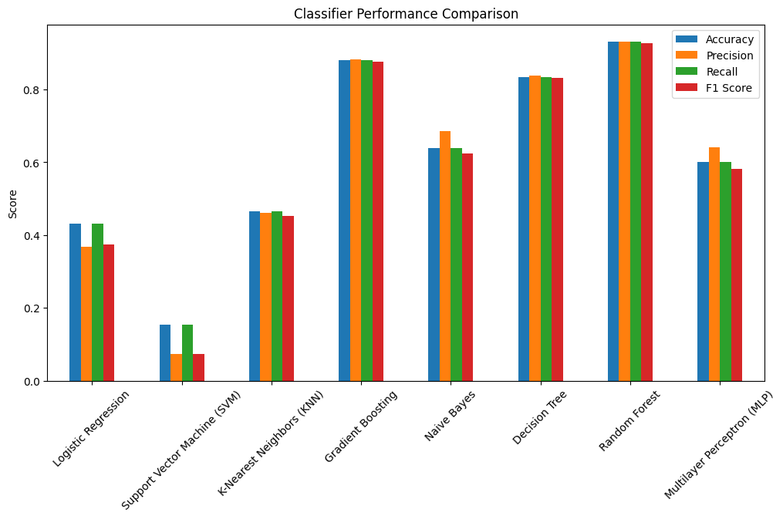
Results (Application Label)
Top-performing Classifiers:
Random Forest: Accuracy = 93.0%, F1 score = 92.7%.
Gradient Boosting: Accuracy = 88.1%, F1 score = 87.7%.
Moderate performers:
K-Nearest Neighbors: Accuracy = 46.6%.
Multilayer Perceptron: Accuracy = 60.1%.
Underperformers:
Logistic Regression and SVM performed poorly, with SVM achieving only 15.3% accuracy.

Slide 12
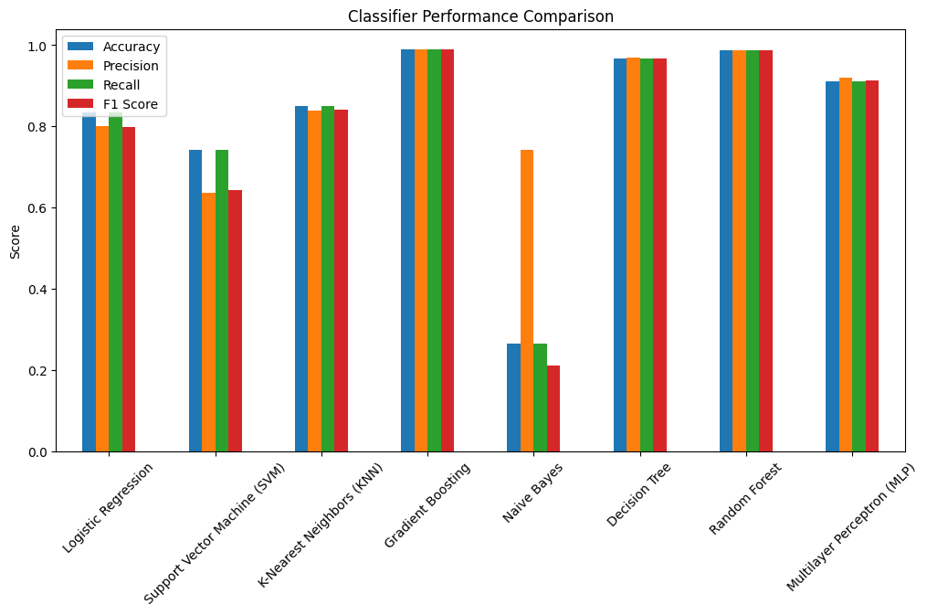
Results (Attribution Label)
Top-performing Classifiers:
Gradient Boosting: Accuracy = 99.0%, F1 score = 99.0%.
Random Forest: Accuracy = 98.8%, F1 score = 98.8%.
Strong performers:
Decision Tree and Multilayer Perceptron performed
well, achieving 96.8% and 91% accuracy, respectively.
Naive Bayes: Performed poorly with only 26.4% accuracy for this label.

Slide 13
Classifier Performance Overview
Ensemble methods like Random Forest and Gradient Boosting consistently outperformed other algorithms in both 'Application' and 'Attribution' labels.
Simpler models like Naive Bayes and SVM struggled with complex datasets.
Decision Tree, though less complex than ensemble methods, also demonstrated strong performance.
Multilayer Perceptron (MLP) and KNN performed moderately well but fell short compared to ensemble methods.

Slide 14
Conclusion
The project developed a comprehensive dataset of encrypted traffic, overcoming limitations of existing datasets.
Ensemble classifiers, particularly Random Forest and Gradient Boosting, provided the best performance in classifying encrypted traffic.
The WebCrawler and dynamic data generation approach ensured real-world diversity in traffic types and conditions.
Future work could focus on improving dataset size and applying deep learning models for even more accurate classification.

Slide 15
Future Work
Expand the dataset to include more traffic types and real-world scenarios.
Explore deep learning models such as convolutional neural networks (CNNs) for improved classification performance.
Investigate the integration of out-of-distribution (OOD) detection methods to handle unseen traffic types more effectively.

Slide 16
Thank You

